Slide 1
Aligning the sales process to the buying process
Martyn Lewis
Principal, 3g Selling™
10th July, 2009
CONFIDENTIAL
1

Slide 2
Introduction
Today’s topic: Aligning Selling to the Buying Process
Today’s speaker: Martyn Lewis
100+ Clients
37,000 sales people
37 Counties
CONFIDENTIAL
2

Slide 3
Premise
15% to 25%
Selling Process
Buying Process
CONFIDENTIAL
3

Slide 4
The power has shifted from the seller to the buyer
The buyer has:
more information
more choice
less resource
less time
The seller has:
less control
less access
less power
more competition
CONFIDENTIAL
4

Slide 5
Customer’s do not buy
in random ways
CONFIDENTIAL
5

Slide 6
Decoding the target market's buying process
Discrete steps
Progression
Dependencies
Key players
Value drivers
Buying needs
CONFIDENTIAL
6

Slide 7
Steady state
Recognition
Definition
Evaluation
Selection
Acquisition
1. Steps
CONFIDENTIAL
7

Slide 8
Steady state
Recognition
Definition
Evaluation
Selection
Acquisition
2. Progression
Progression
Stops
Regression
CONFIDENTIAL
8

Slide 9
3. Dependencies
The “whole” product
What else is required to achieve the requirement?
CONFIDENTIAL
9

Slide 10
4. Key Players
No longer a single decision maker
Network of influence
CONFIDENTIAL
10

Slide 11
5. Value Drivers
Individualistic
Beyond tangible requirements
CONFIDENTIAL
11

Slide 12
6. Buying needs
What is required or needed from a supplier?
Is the customer “Solution Buying”?
Who has the knowledge?
CONFIDENTIAL
12

Slide 13
Steady state
Recognition
Definition
Evaluation
Selection
Acquisition
Decoding the buying process
Discrete steps
Progression
Dependencies
Key players
Value drivers
Needs
CONFIDENTIAL
13

Slide 14
Steady state
Recognition
Definition
Evaluation
Selection
Acquisition
Aligning selling with buying
Initiate
Assess
Validate
Present
Confirm
Close
Sales Strategy
Synchronize selling activity to buying process
CONFIDENTIAL
14

Slide 15
Steady state
Recognition
Definition
Evaluation
Selection
Acquisition
Reactive to proactive
Initiate
Assess
Validate
Present
Confirm
Close
Increase probability of being selected
Increase size of investment
Decrease time to commitment
CONFIDENTIAL
15

Slide 16
Real-life examples
Aligning the selling process to the buying process
Stopping random acts of selling
CONFIDENTIAL
16

Slide 17
Example 1: Steps
Disappearing up-sell
$k
CONFIDENTIAL
17

Slide 18
Steady state
Recognition
Definition
Evaluation
Selection
Acquisition
First call
Qualify
Present
Forecast
Close
Example 1: Steps
It is all about where the customer is in their buying process, not where you think you are in a selling process
CONFIDENTIAL
18

Slide 19
Steady state
Recognition
Definition
Evaluation
Selection
Acquisition
Example 1: Steps
Initial Validation
Ensure total solution is in scope
Collaborate on business case
Confirm scope and value
Detailed Proposal
Close
It is all about where the customer is in their buying process, not where you think you are in the selling process
CONFIDENTIAL
19

Slide 20
Example 2: Progression
Responding to the RFP
< 5%
CONFIDENTIAL
20

Slide 21
Steady state
Recognition
Definition
Evaluation
Selection
Acquisition
Steady state
Recognition
Definition
Evaluation
Selection
Acquisition
Example 2: Progression
Pushing the customer back in their buying process
CONFIDENTIAL
21

Slide 22
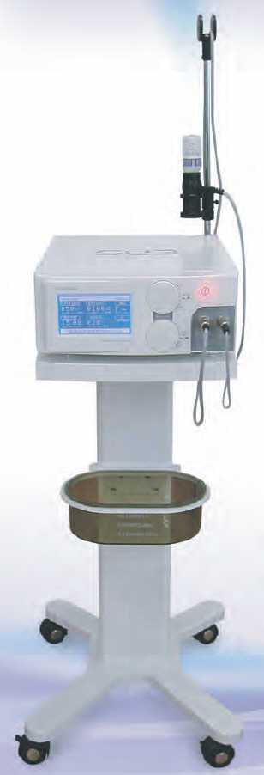
Example 3: Dependencies
“Only a fool wouldn’t buy”
Cheaper
Faster
Reduction of toxic waste
CONFIDENTIAL
22

Slide 23
Example 3: Dependencies
“Only a fool wouldn’t buy”
New processes
Different supplies
Extensive retraining
Modified materials handling
CONFIDENTIAL
23

Slide 24
Steady state
Recognition
Conceptual Direction
Business case
Approval
Acquisition
Example 3: Dependencies
Initiate
Set Scope
Agree on partnership
Develop- business case
Validate
Close
Match solution to total requirement
Position to sell total service, not just the product
CONFIDENTIAL
24

Slide 25
Example 4: Key Players
The commodity trap
Prisoner to the reverse auction
CONFIDENTIAL
25

Slide 26
Steady state
Recognition
Validate Direction
Prioritize and gain funding
Price contest
Purchase
Example 4: Key Players
Agreement to Evaluation
Build Business Case
Detailed Business Proposal
Select first initiative
Present best price
Supply
Price and availability driven buying/selling process
CONFIDENTIAL
26

Slide 27
Steady state
Recognition
Validate Direction
Prioritize and gain funding
Implementation plan defined
Acquisition
Example 4: Key Players
Agreement to Evaluation
Build Business Case
Detailed Business Proposal
Select first initiative
Detailed Proposal
Close
Starting a new buying process with new players
CONFIDENTIAL
27

Slide 28
Example 5: Value Drivers
Brand schizophrenia
Some get it, some don’t
CONFIDENTIAL
28

Slide 29
Steady state
Recognition
Definition
Evaluation
Selection
Acquisition
Example 5: Value Drivers
Initial Assessment
Conceptual Solution
Qualify in or out
Collaborate on business case
Detailed Proposal
Close
Don’t add value to waste
Focus on the market that values your value
CONFIDENTIAL
29

Slide 30
Example 6: Buying Needs
Solution selling or Solution buying?
CONFIDENTIAL
30

Slide 31
Knowledge
Evaluate
Select
Acquire
Example 6: Buying Needs
Ongoing information exchange
Reinforce differentiation
Confirm requirements
Manage service excellence
Not everyone wants a “trusted advisor”
Some buyers know exactly what they want, and they are right!
CONFIDENTIAL
31

Slide 32
Third generation selling
Synchronizing selling to buying
15% to 25% increase in sales results
The right selling activities, at the right time, against the right opportunity
Effective
Focused
Precise
CONFIDENTIAL
32

Slide 33
Resources
www.3gselling.com
One-hour of free consulting with a Principal from 3g Selling™
How you can decode, or validate, your own target market’s buying process
martyn.lewis@3gselling.com
CONFIDENTIAL
33

